Slide 1


Slide 2

Success in the premier league
DATA SCIENCE FINAL PROJECT
RON ASHKENAZI
GAL SINAI
GitHub

Slide 3
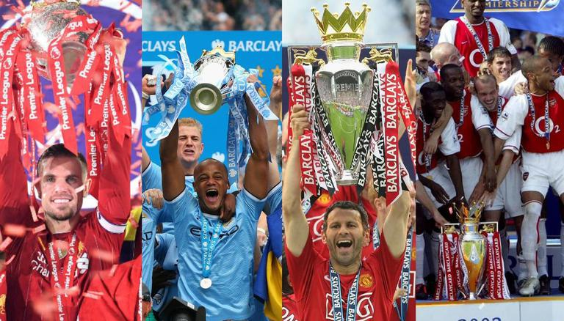
OUR RESEARCH:
How can a premier league side maximize its potential?
Can we predict which teams will be in the top four spots at the end of the season?
EDA
&
Visualization
Collecting data
& Crawling
Prediction &
Conclusions
Data Handling

Slide 4

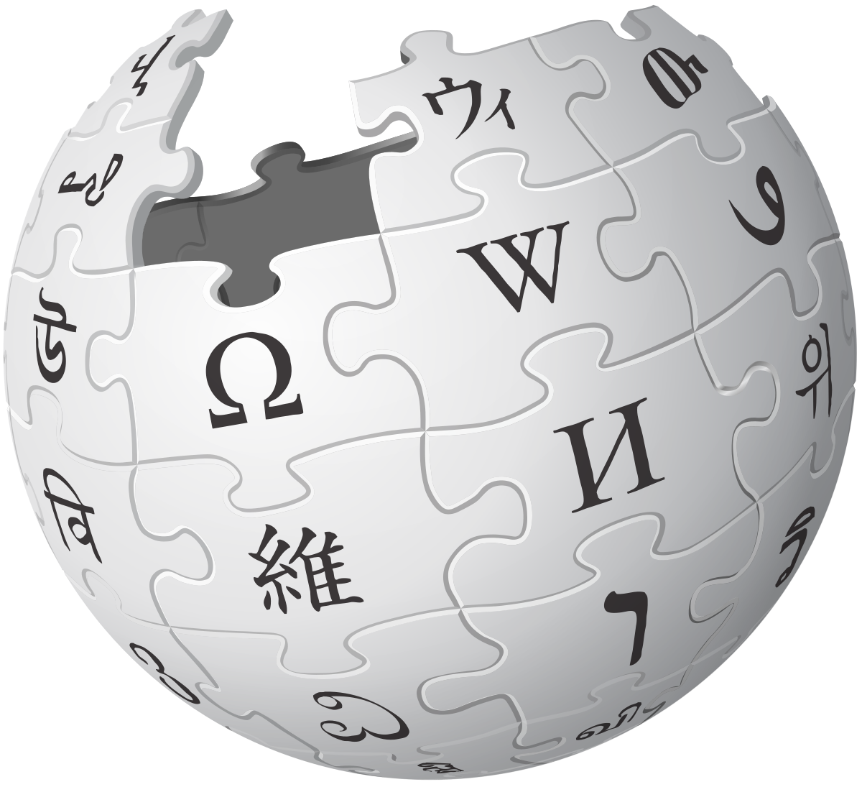
OUR SOURCES:
Crawling:
FBREF
Wikipedia

Slide 5
Crawling - Wikipedia:
We used a built-in function in Python’s Pandas to crawl and collect the relevant data from Wikipedia.
The records saved into ‘wiki_tables’ – a list which contained the league final tables for each season from the last decade.

Slide 6
Crawling - FBREF:
We used a Selenium Webdriver library in Python to crawl and collect the relevant data about every player from every team in the last decade.
The records saved into ‘season#Years’ – dataframes that contained the league final stats about every player for each season from the last decade.

Slide 7
Data Handling:
We removed irrelevant players who had no influence on the team (played under 45 minutes during each season).
We removed irrelevant columns which we had no interest to use.
We handled missing values.
In order to cross between the two different sources, we had to match the values between them.
Finally, we had to filter 80,000 data points into 60,000 more or less.

Slide 8
EDA & VISUALIZATION:
We decided to investigate the differences between the Top four to the rest of the teams each season.
We chose five features of the teams' players to investigate, according to the data we collected:
1. The percentage of the most common nation among players in a team.
2. The age average in a team.
3. The number of players average in a team.
4. Rotation between the players in a team.
5. Player’s concrete attack involvement in a team (Goals and Assists).

Slide 9
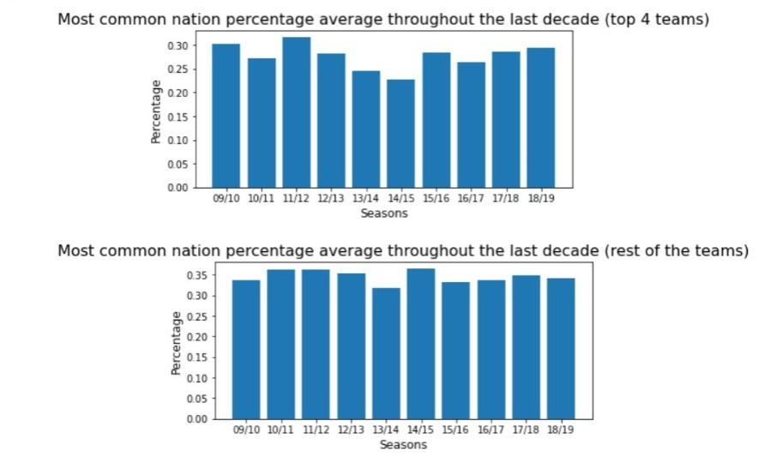
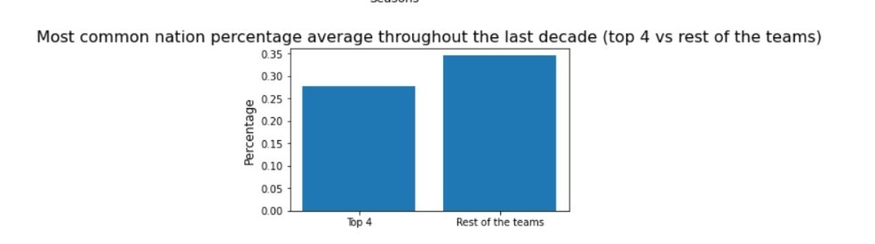
EDA & VISUALIZATION:
1.
From the charts we concluded that teams from the Premier League should have more variety of players from different nation across the world in order to finish in Top Four spot.

Slide 10
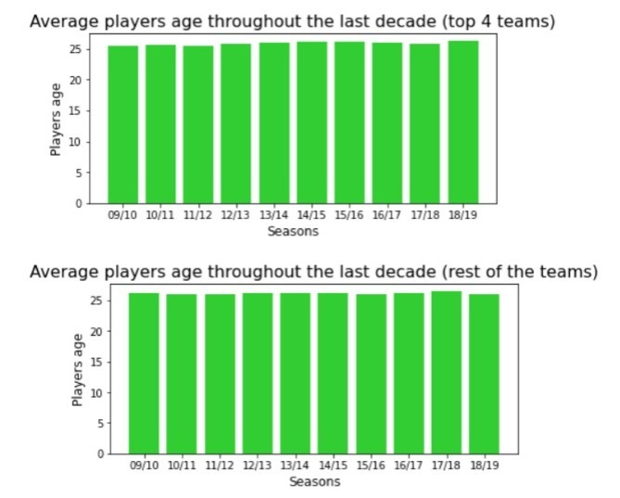
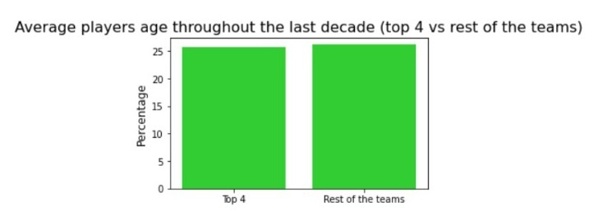
EDA & VISUALIZATION:
2.
From the charts we inferred that teams from the Premier League have very similar age average, so that data is not essential to finishing at Top Four spot.

Slide 11
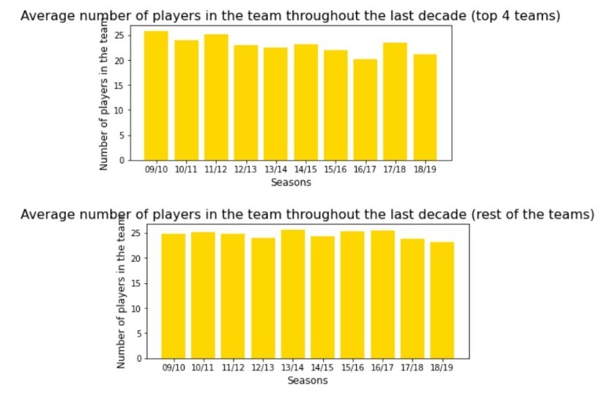
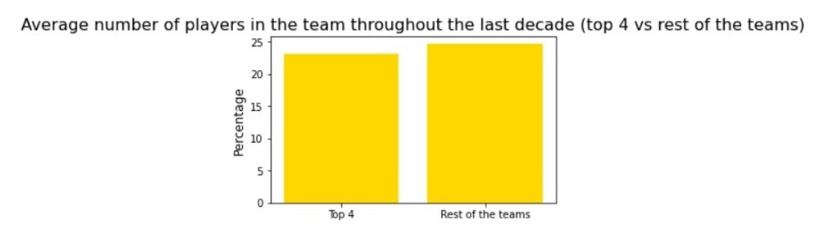
EDA & VISUALIZATION:
3.
From the charts we inferred that teams from the Premier League have very similar number of players, so that data is not essential to finishing at Top Four spot.

Slide 12
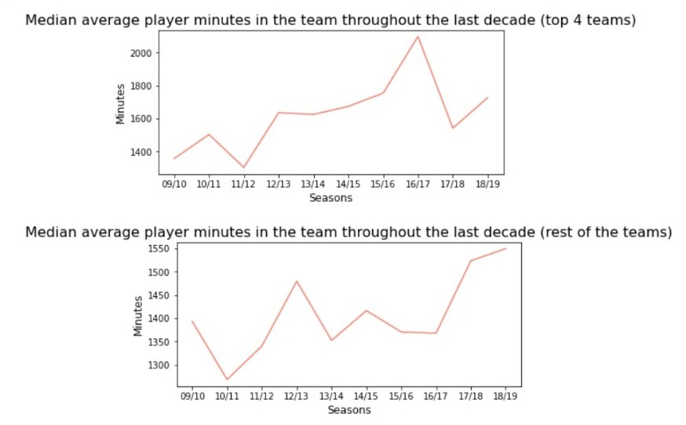
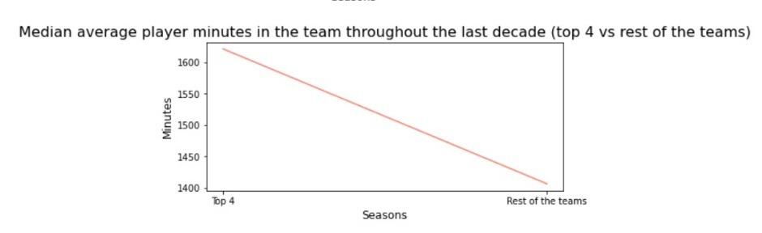
EDA & VISUALIZATION:
4.
We calculated the rotation of players during the seasons with the medians average of the players minutes for each team, and with the charts we concluded that the Top Four teams less rotate.

Slide 13
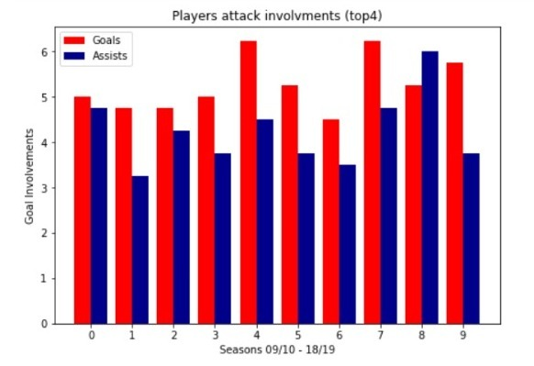
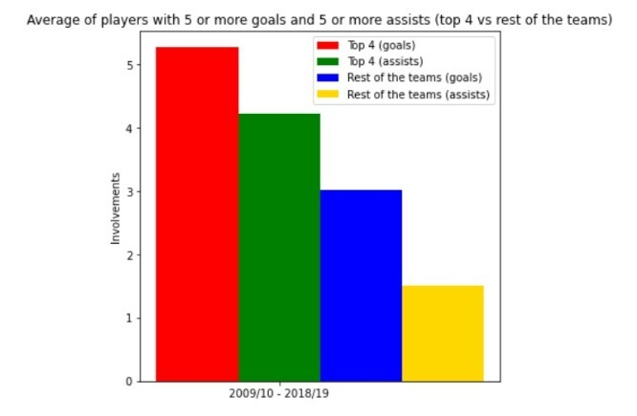
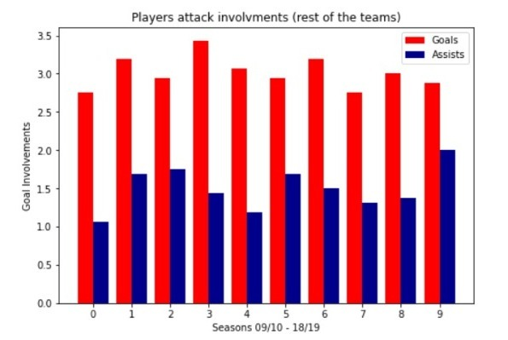
EDA & VISUALIZATION:
5.
From the charts we inferred that more players from Premier League teams must score and assist more than 5 goals in order to take Top Four spot at the end of the season.

Slide 14
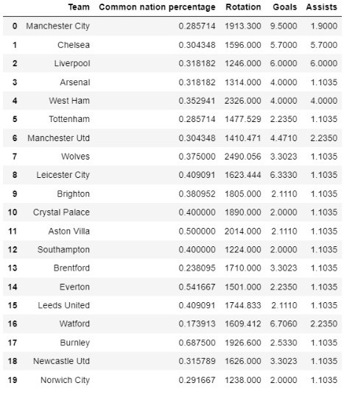
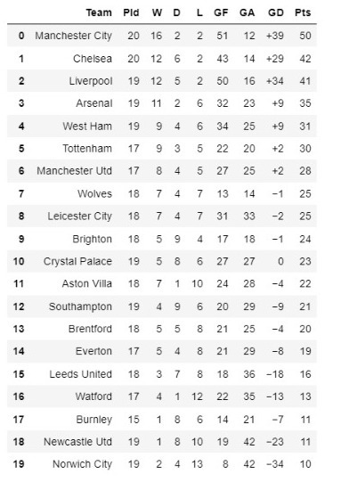
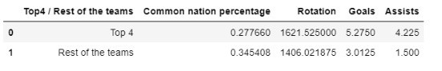
Prediction & Conclusions:
We collected the data from the EDA and Visualization phase and created a new data frame which contains the current Premier League teams and their stats according to our research.
It is the middle of the season in the Premier League so we calculated with linear ratio, the stats we need in order to predict how the stats will look like in the end of the season.
The Goals column means players with 5 or more goals, the same for the Assists column.
The calculated stats of the last decade.

Slide 15
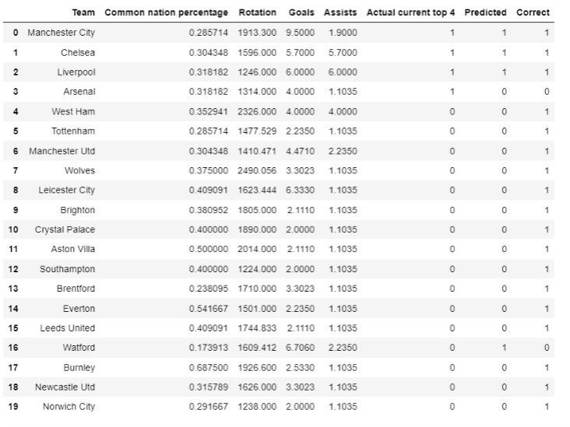
Prediction & Conclusions:
After we finished organize our conclusions regarding the last decade’s Premier League with the relevant attributes, and after we predicted the current season stats for the end of the season now, we have the data we needed to try and predict which team is suitable to Top Four spot according to our EDA conclusions.
We created an algorithm which determines if the team have the most suitable attributes to a Top Four spot.
In conclusion, we can see that the algorithm is accurate with 90% accuracy.
We found out that the most suitable teams to finish in Top Four spot are Man City, Liverpool and Chelsea, clearly.
Watford is a standard deviation case.

Slide 16

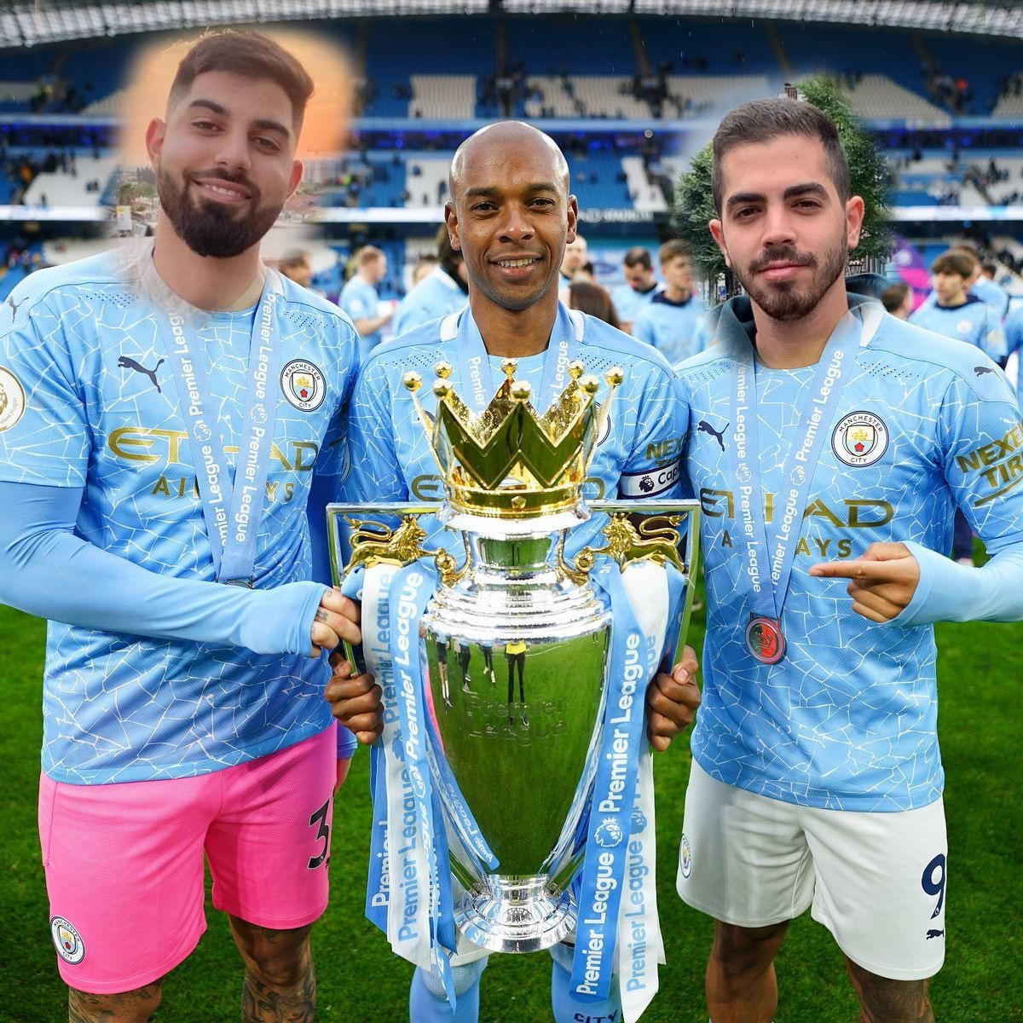
THANKS FOR LISTENING!
By:

